Slide 1
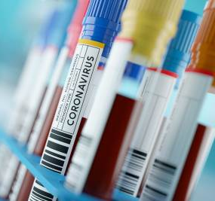
ANALYSIS OF COVID-19 CASES IN NIGERIA
PRESENTED BY: PAULINA ILIYA
DATE:23/3/2024

Slide 2
INTRODUCTION
The inception of the COVID-19 pandemic has precipitated a dramatic loss of human life globally and had posed an inestimable obstacle to public health, food security, and economic impact.
Nigeria like other African countries has had its own share of the impact of the pandemic.
This study seek to analyse the impact of the pandemic in the worst hit state with the aim of understanding the strategies employed for control.

Slide 3
OBJECTIVE
To determine the state with the highest COVID-19 cases in Nigeria.
To examine the strategies to control the Pandemic

Slide 4
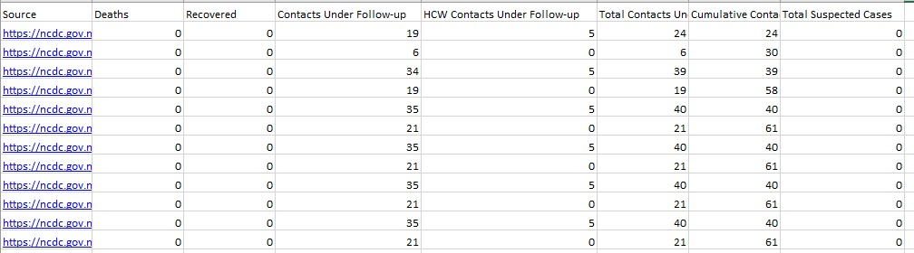

ABOUT DATA

Slide 5
METHODOLOGY
The study was done through analysis of a data set proved online at ncdc.gov.ng and an online research about how Lagos state control the COVID-19 Pandemic.

Slide 6
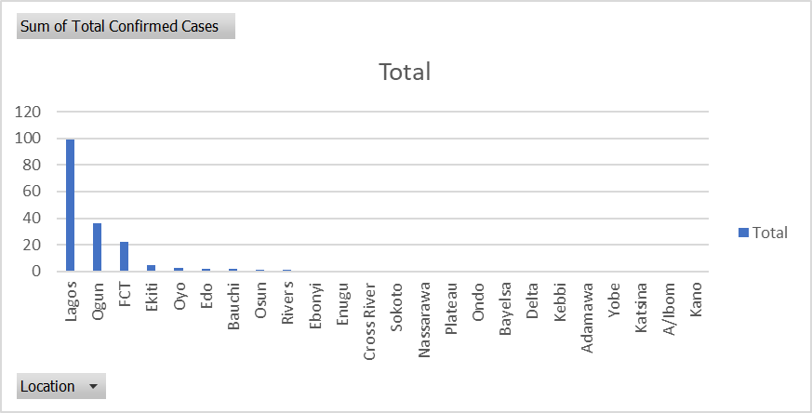
RESULT AND DISCUSSION

Slide 7
RESULT AND DISCUSSION
An analysis of the data set obtained from ncdc.gov.ng revealed that lagos state is the worst hit with total confirmed case of 99.
Lagos is notorious for its congested and poorly maintained road networks. Traffic jams are a daily occurrence, leading to lost productivity and increased stress for commuters.
COVID-19 preventive measures in the country include hand washing, use of sanitizers, wearing of face masks, lockdown and social distancing. Factors which undermined government preventive efforts were poor compliance attitude, selective lockdown, social media interference, misconceptions and myths, stigmatization, fear, inadequate health facilities, and distrust for government.

Slide 8
RECOMMENDATION
1. Roads and Transportation
Challenge: Lagos is notorious for its congested and poorly maintained road networks. Traffic jams are a daily occurrence, leading to lost productivity and increased stress for commuters.
Solution:
Invest in Road Expansion: Expanding existing roads and constructing new ones can help ease traffic congestion.
Public Transportation: Develop a reliable and efficient public transportation system, including buses and railways, to reduce the reliance on private vehicles.
Smart Traffic Management: Implement intelligent traffic management systems to monitor and control traffic flow.
2. Power Supply
Challenge: Unreliable electricity supply is a significant hindrance to businesses and households in Lagos. Frequent power outages disrupt daily life and hinder economic growth.
Solution:
Invest in Renewable Energy: Promote the use of solar and wind energy to supplement the grid and provide uninterrupted power supply.
Upgrade the Power Grid: Modernize and expand the power grid to ensure a stable electricity supply.
Encourage Independent Power Producers (IPPs): Attract private investors to generate and distribute power.
3. Sanitation and Waste Management
Challenge: Inadequate waste disposal and sanitation facilities contribute to environmental pollution and public health concerns.
Solution:
Waste Recycling: Promote waste recycling initiatives to reduce landfill waste.
Sanitation Education: Launch public awareness campaigns on proper waste disposal and sanitation practices.
Invest in Infrastructure: Build sewage systems and waste treatment plants to manage sanitation effectively.

Slide 9
CONCLUSION
Lagos, despite its numerous challenges, has immense potential for growth and prosperity. Addressing its infrastructure deficiencies is crucial for unleashing this potential.
By implementing these solutions and fostering collaboration between government agencies, private investors, and the community, Lagos can overcome its infrastructure challenges and become a model for controlling any Pandemic.

